Slide 1


Adapter Box
introduction
www.solaxpower.com

Slide 2
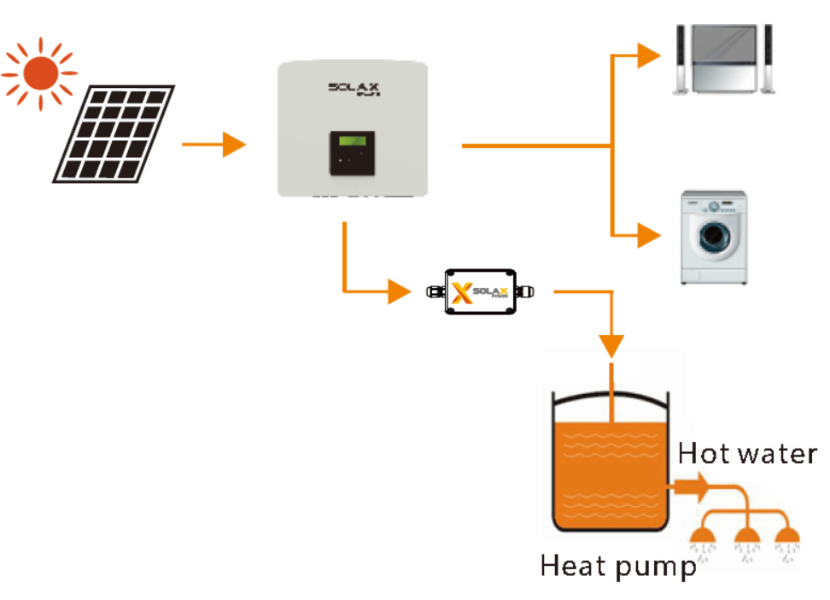


Introduction
SolaX Adapter box is matched with a heat pump with dry contact function, which can realize heat pump integrated photovoltaic inverter energy system management.

Slide 3

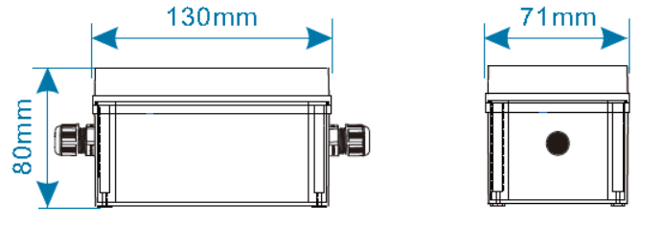
Overview
This is the appearance and size of the machine, this one is very small.

Slide 4
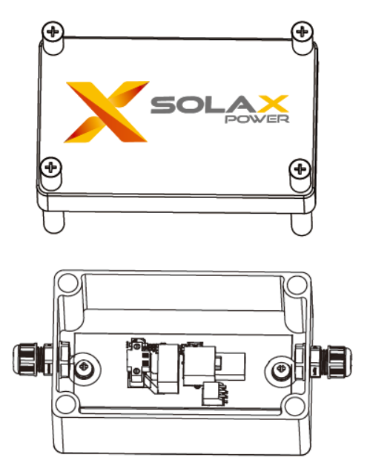

Internal display

Slide 5
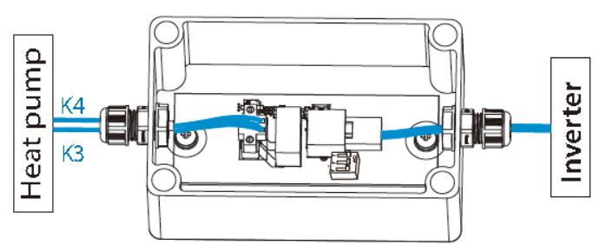
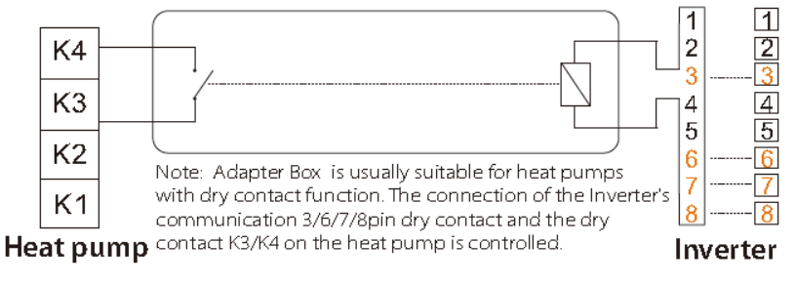
Overview
Which port is used for the heat pump to start, the specific need to be based on the heat pump (different manufacturers have different definitions, here K3\K4 are just examples)
The network cable needs to be made by yourself, please refer to the quick installation guide.
The energy storage machine uses the COM port, and the grid-connected machine uses the 485 port.

Slide 6
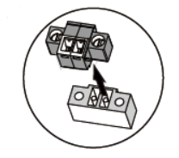
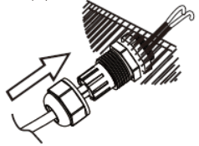
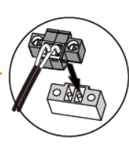
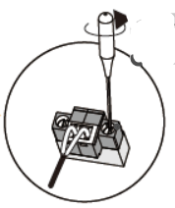
Wiring
module | COM&RS485 PIN Definition | DIP switch
X1-Hybrid-G4 X3-Hybrid-G4 | 3, 6, 7 and 8 | OFF（default）
BOOST G3.2 | 3 and 6 | NO

Slide 7
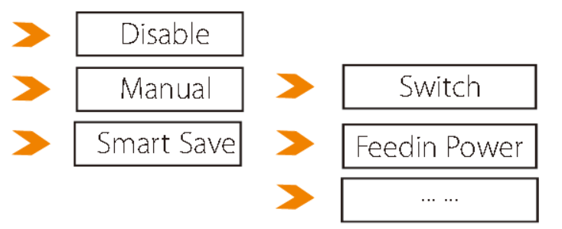
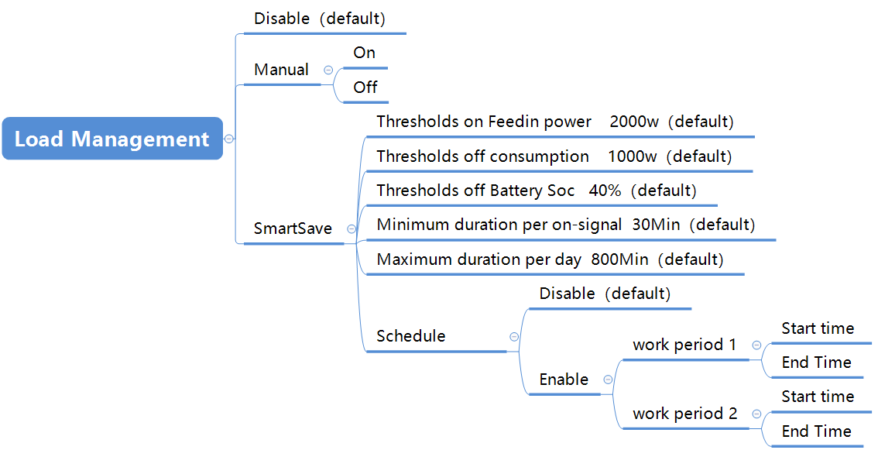
Work mode

Slide 8
Work mode
work mode | work status
Disable | Disable is the default working mode of Load Management. In this mode, the relay of the machine to control the heat pump is closed, which means that the heat pump does not work.
Manual | In this mode, you can freely switch the heat pump on or off.
SmartSave | Thresholds on Feedin power 2000w（default）:This is when the grid-connected power of the machine is greater than this value, the machine will turn on the heat pump.
 | Thresholds off consumption 1000w（default）:This is when the meter samples and the power drawn from the grid is greater than this value, the machine will turn off the heat pump.
 | Thresholds off Battery Soc 40%（default）:This restriction condition is parallel to the previous condition (Thresholds off consumption). If the power drawn from the grid does not reach the Thresholds off consumption value, but the SOC of the battery reaches the protection value, the inverter will also shut down the heat pump.
 | Minimum duration per on-signal 30Min（default）：This limitation is to limit the 30 minutes required for each operating mode switch to protect the relay.
 | Maximum duration per day 800Min（default）：This limit is the time of using the heat pump in a day. If the running time is greater than this value, the inverter will also shut down the heat pump.
 | Schedule: This timetable is closed by default. In this mode, a total of two time axes can be set. When the system time of the machine is in this time axis, the machine will turn on the heat pump.

Slide 9


